Slide 1

Education Connection Express: Unleashing Tennessee's Academic Potential
A Journey Through Data, Discovery, and Empowerment
Patrick Johnston
8/18/2023

Slide 2

All Aboard the Learning Express: Next Stop, Discovery!
Get ready for an Exciting Expedition Through Tennessee’s Educational Landscape
Hop aboard the Education Connection Express, where the thrilling ride through Tennessee's academic wonderland awaits! Disclaimer: While I can't promise literal seat-jumping excitement for passengers already onboard this adventure, I do guarantee a journey full of meaningful discovery and insight. With the mighty quartet of Python, Excel, Power BI and Tableau at my disposal, let's make a positive impact on our youth and unleash the potential of our future leaders. So, fasten your seat belt and get ready for a detailed and fun, yet enlightening experience!

Slide 3
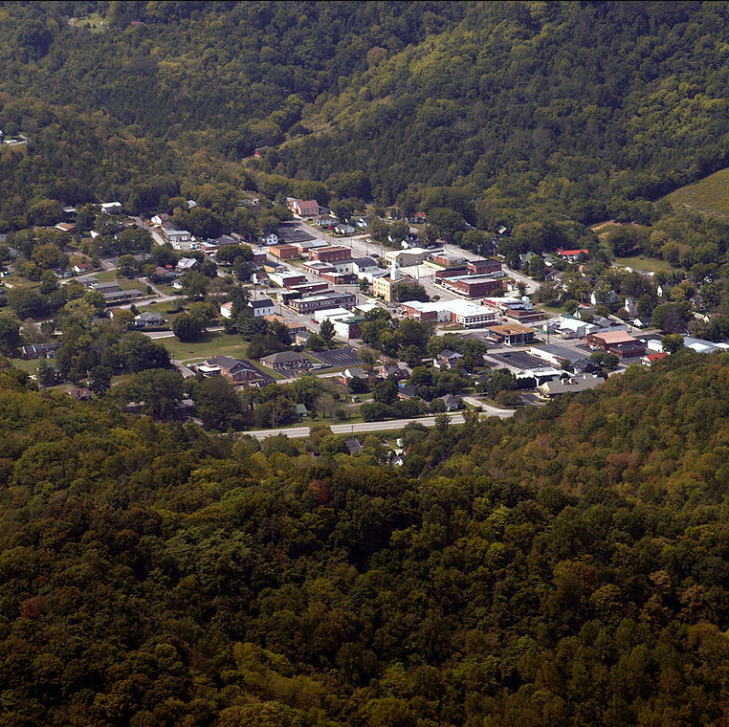
Motivation
Growing up in the beautiful hills of Jackson County, TN, I've seen the struggles and triumphs of chasing a college dream. With more ups and downs than a roller coaster at Dollywood, the pursuit of a degree is no joke – but that doesn't mean we can't explore along the way! My capstone attempts to level the playing field, by turning education from a privilege into a right, and about giving every kid (no matter the background) a ticket to ride the 'Education Connection Express.' Choo choo, all aboard for change!

Slide 4

The Education Connection Express: MVP Overview
Through exploration of possible key factors influencing college-going and educational attainment rates in different Tennessee counties, the MVP will leverage numerous governmental datasets by way of Excel, Python, and Tableau/Power BI for data exploration, analysis, visuals, and reporting discovered information.

Slide 5
First Stop: The Curious Junction of Data Questions
1) What are the key factors influencing college-going rates and educational attainment in different Tennessee counties?
2) How do these factors shape undergraduate degree completion?
3) How do they shape financial aid accessibility?

Slide 6
Issue at Hand:
Students and Adults in different Tennessee counties have varying college-going rates and educational attainment levels. Metrics such as Bachelor Degree completion- especially among economically disadvantaged students, will be further explored.

Slide 7
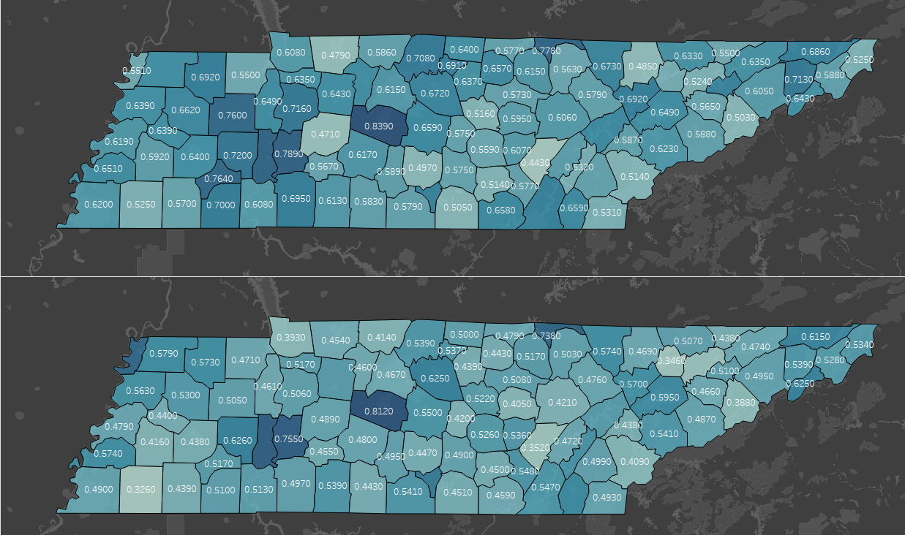
Notes:
College going rates. Counties such as Jackson, Fayette, Shelby, and Stewart county all had noticeable drops in college going attendance, but counties like Williamson and Perry managed to remain somewhat similar. Could this be a covid or financial factor or both?

Slide 8
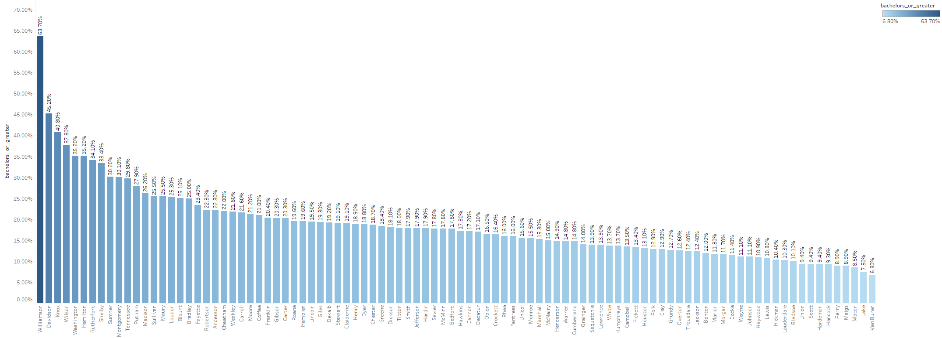
Bachelor Degree Attainment Per County
1st – Williamson – 60%
2nd – Davidson – 38%

Slide 9
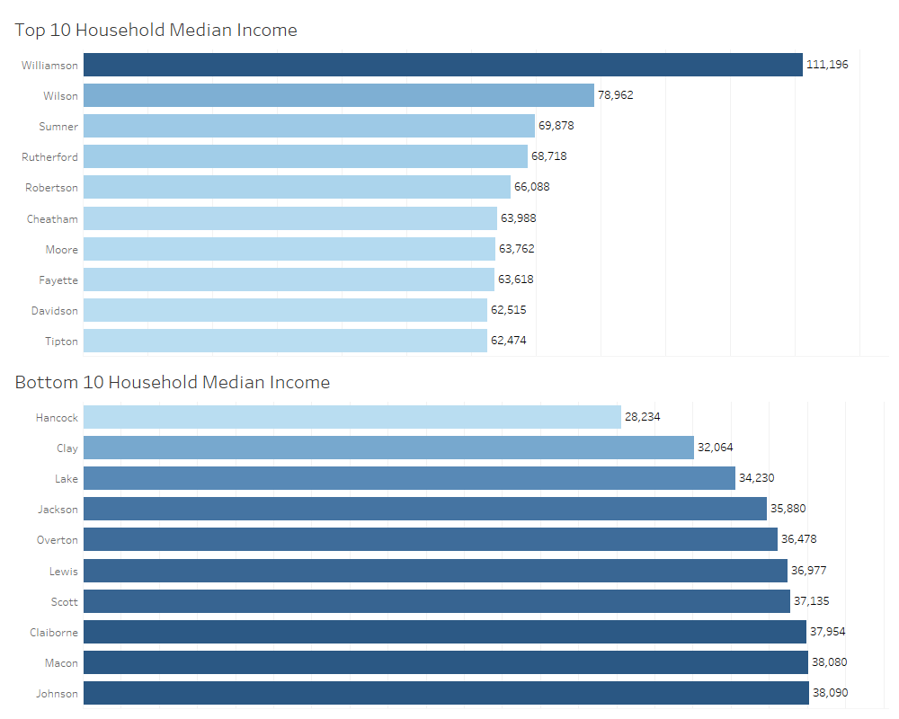
Notes:
(2021 – ACS CENSUS) Table for geographical mobility in past year by education attainment for current residence. (moved from different county within state, moved within same county, moved from diff. state, same house, moved from abroad And totals for all. (per census Margin of Error explanation – numbers are represented with 90% confidence.

Slide 10
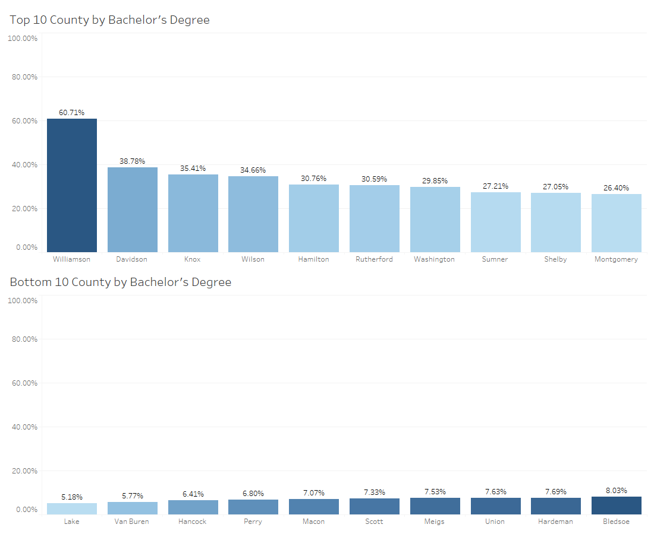
Any disparities?
Notes:
This telling, yet unfortunate chart displays a county’s percentage of adults compared to their county’s total population that have obtained at least a Bachelor’s Degree.

Slide 11
ReadyGrad and Economically Disadvantaged (As defined by Tennessee Higher Education Committee)
ReadyGrad
ACT 21 or over
Increase the ReadyGrad%, increase the scholarships for students.
Economically Disadvantaged
Reduced / Free Lunch
Financial Assistance / Aid
Poverty Rate variables

Slide 12
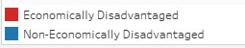
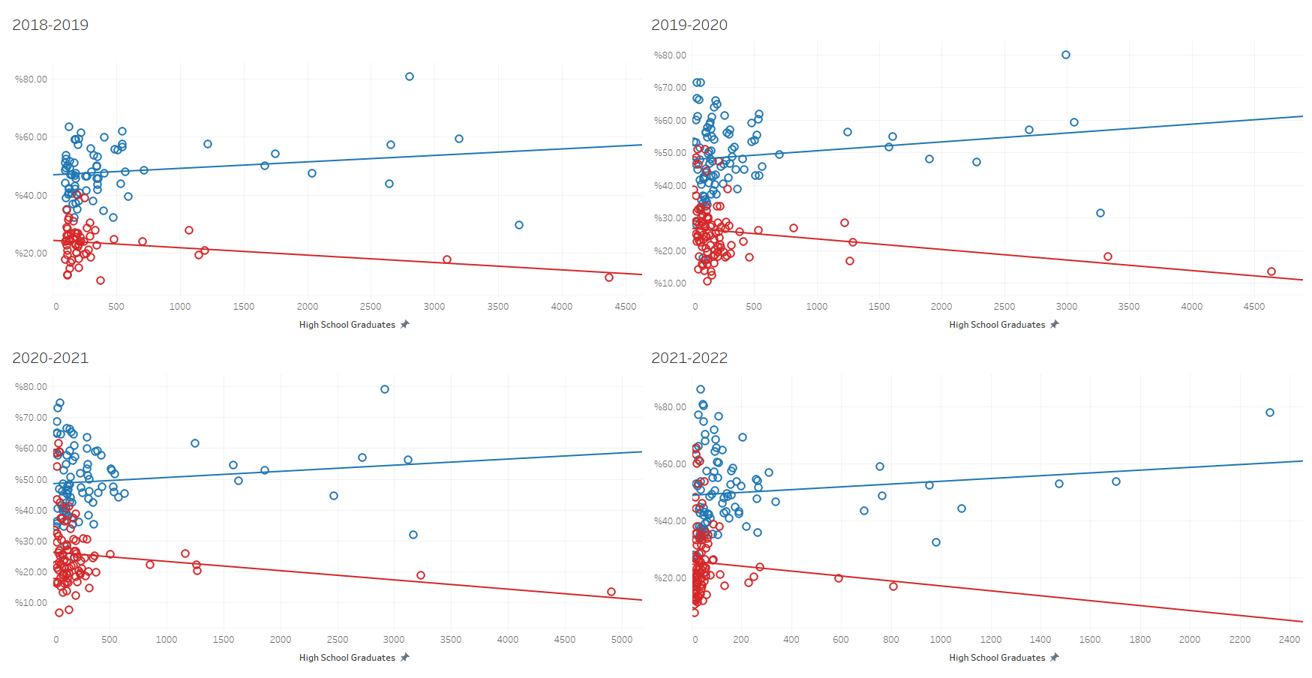
Notes:
I wanted to look further into the trends over the years of counties, and their metrics with ready-grad students for financial disparities to see if there could be any correlation found. Higher concentrated schools tend to skew lines, but still noticeable separation between economically and non-economically disadvantaged.

Slide 13
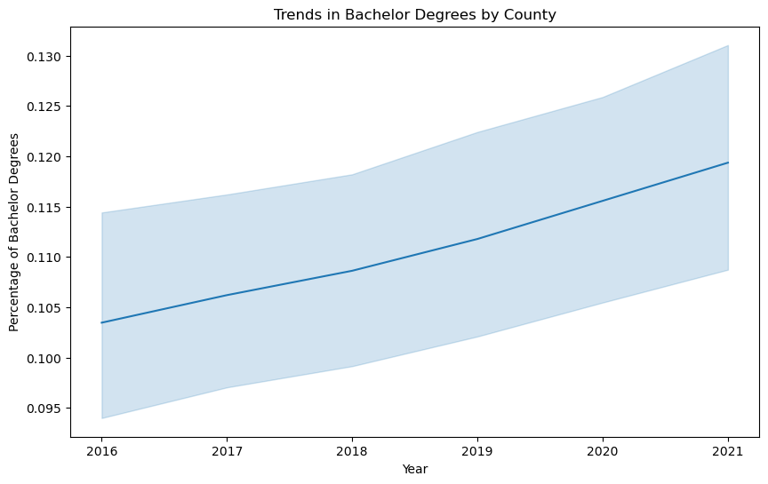
Looking forward
Notes:
Bachelor Degree attainment rates are trending upwards, but the economically disadvantaged kids based on the TN grad metrics still haven’t changed much at all.

Slide 14
Data Sources
TN.gov
US Census
Tennessee Higher Education Commission
Notes:
(2021 – ACS CENSUS) Table for geographical mobility in past year by education attainment for current residence. (moved from different county within state, moved within same county, moved from diff. state, same house, moved from abroad And totals for all. (per census Margin of Error explanation – numbers are represented with 90% confidence.

Slide 15
Q & A
Questions?

Slide 16
Acknowledgments & Thank You
My gratitude for Nashville Software School and their Nashville Opportunity Scholarship for students like me and believing in me and my potential to empower the community and give back just like they did for me… because otherwise I wouldn’t be here. I’d still be smelling like delicious Italian food breaking my back every day. Weave this in as a final ending point for investing and supporting people who may not have all the credentials, but you can’t teach willingness and effort.

